Slide 1



FINAL REVIEW
SEMDRIFT: A JOINT ENCODER APPROACH TO SOURCE CODE SEMANTIC CONSISTENCY VERIFICATION
TEAM
PRADEEP BEHERA
AADHITHYA T
MOHAN RAJ V
23619224
23619236
23619246
B.TECH CSE (AI&ML)
B.TECH CSE (AI&ML)
B.TECH CSE (AI&ML)
GUIDE NAME : DR.K. ULAGAPRYA M.E, PH.D

Slide 2

PROBLEM STATEMENT
  As codebases evolve, docstrings are frequently left outdated or inconsistent with the actual behavior of the functions they describe — since there's no automated check enforcing that they stay in sync — which misleads developers, breaks IDE tooling, and reduces the reliability of any system that consumes these descriptions (e.g., documentation generators, code search, LLM-based coding assistants)
  Existing solutions either rely on manual code review (slow, inconsistent, easy to miss) or lack a reliable automated way to detect semantic drift between code and docstrings — as opposed to just surface-level or syntactic mismatches — creating a need for a learned model that can catch drift a human reviewer might miss

Slide 3

OBJECTIVES
  Detect semantic drift between a Python function and its docstring using only the current (code, docstring) pair, without relying on commit history
  Construct a labeled synthetic mutation dataset via severity-graded mutations (mild / moderate / severe) while preserving original docstrings
  Design and evaluate a shared bi-encoder architecture against a dual-encoder and a frozen baseline for the drift-classification task
  Recalibrate the classification threshold to favor precision, so flagged results remain trustworthy for developers
  Package the trained model as a lightweight command-line tool for integration into pre-commit hooks and CI pipelines

Slide 4
LITERATURE SURVEY
USE CASE | DISADVANTAGE | TITLE
BASE PAPER — BiGRU + multi-head attention using pre/post code versions to detect comment inconsistency | Requires commit history (before/after code); cannot assess a standalone code-docstring pair | Deep Just-in-Time Inconsistency Detection (Panthaplackel et al. - 2021)
LLM-based, multi-language (Python/TS/C++/Java) detection, no diff needed; 124-pair verified Python gold set | Relies on LLM inference; needs false-positive filtering (LCEF) to reach usable precision | DocPrism: Local Categorization and External Filtering for Code-Doc Inconsistencies (Xu et al. - 2025)
Introduces CCIBench, a cleaned high-quality dataset; end-to-end LLM detect+repair framework | Java-only, still built on commit diffs (JITData) unlike SemDrift's standalone-pair approach | CCISolver: End-to-End Detection and Repair of Code-Comment Inconsistency (Zhong et al. - 2025)
SOTA LLM-based detection + repair; contrasts with SemDrift's lightweight classification-only approach | Heavyweight LLM inference, too costly for real-time developer tools | DocChecker: Bootstrapping Code LLM for Detecting and Resolving Code-Comment Inconsistencies (Anh Dau - 2024)
Validates fusing AST structure with semantic embeddings for mismatch detection | Complex AST-fusion pipeline with no severity-level classification | ASKDetector: AST-Semantic and Key Features Fusion Based Code Comment Mismatch Detector (Haiyang Yang - 2024)

Slide 5
PROPOSED SYSTEM
FROM CODE + DOCSTRING → SEMANTIC REPRESENTATION → DRIFT CLASSIFICATION → DEVELOPER FEEDBACK
SemDrift detects semantic drift between a Python function and its docstring using only the current code–docstring pair — no commit history or before/after versions required.
Constructs labeled data through severity-graded semantic mutations while preserving the original docstring, and extends this with a real-drift mining track for naturally occurring changes.
Uses a fine-tuned CodeBERT-based joint bi-encoder to map code and documentation into a shared semantic space and classify pairs as ALIGNED or DRIFTED.
Provides lightweight developer integration through a CLI and check-drift endpoint for pre-commit and CI workflows.
Key contribution: standalone-pair detection that combines semantic representation, severity awareness, and practical deployment.

Slide 6
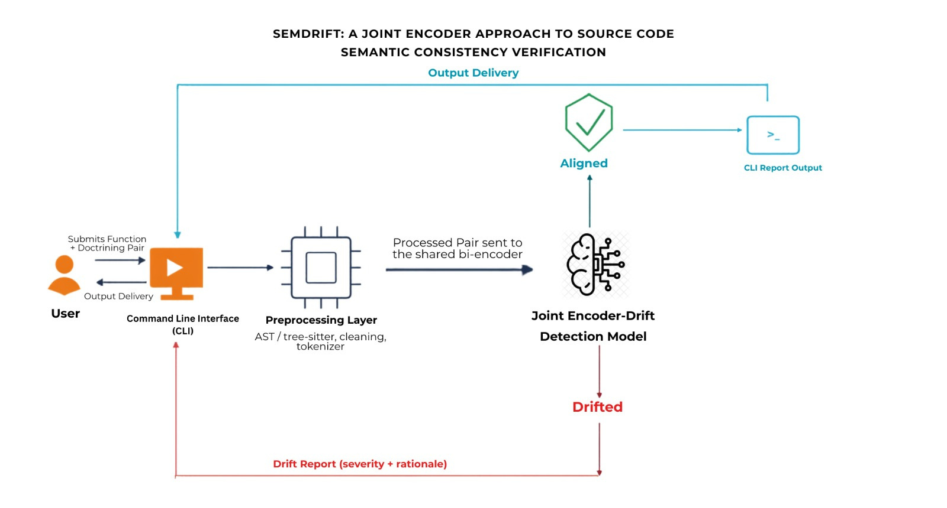
SYSTEM ARCHITECTURE

Slide 7
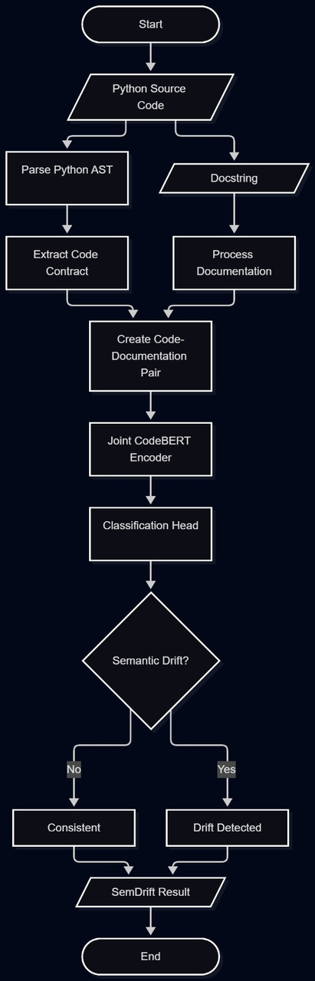
FLOW CHART

Slide 8
MODULES
  Dataset Construction Module
  Data Preprocessing Module
Builds the labeled training corpus via two tracks — severity-graded synthetic mutations (parameter, return-value, behavior changes) and real git-history mining (commit-filter to AST-diff to LLM-ensemble-vote) — to capture genuine semantic drift.
Parses Python source files using AST to extract function-level code and docstring contracts, then normalizes and tokenizes each code-documentation pair for downstream processing.
  Joint Encoder Drift Detection Module
  CLI Integration Module
A fine-tuned CodeBERT-based bi-encoder trained with severity-weighted cosine similarity loss; embeds code and docstring into a shared semantic space and classifies each pair as aligned or drifted.
A lightweight CLI for pre-commit hooks and CI pipelines; returns a drift report with severity and rationale.

Slide 9
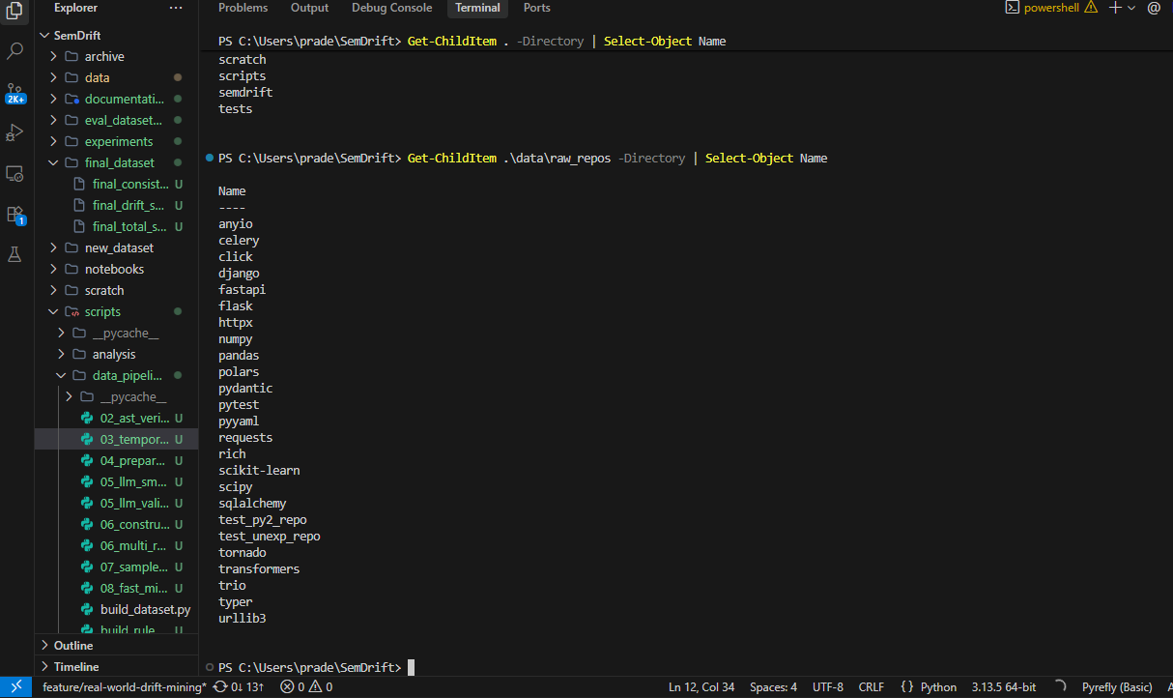
IMPLEMENTATION
01 Data Pipeline
Repository mining → function extraction → code–docstring pairing

Slide 10
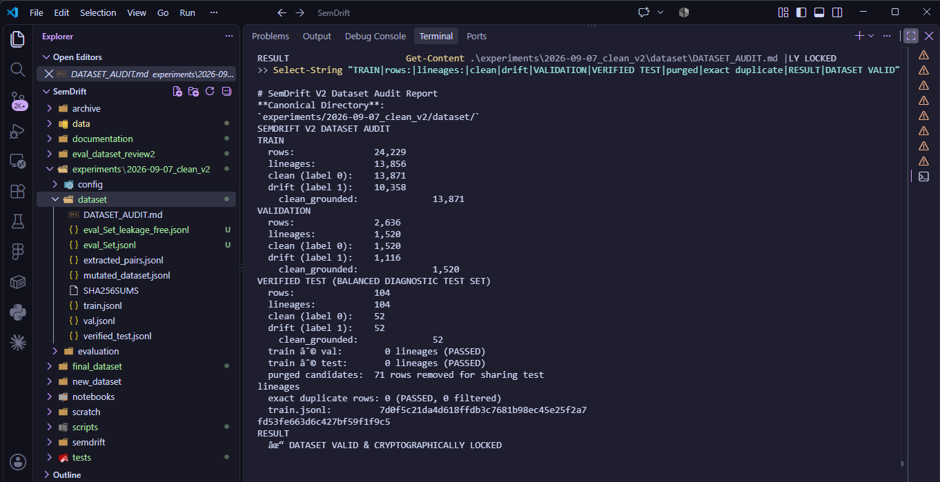
IMPLEMENTATION
02 Dataset
Severity-graded semantic mutations → aligned / drifted labels01 Data Pipeline

Slide 11
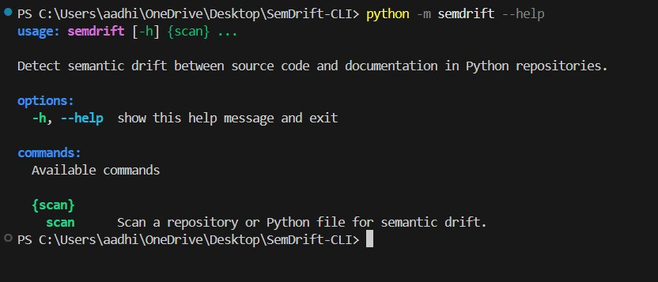
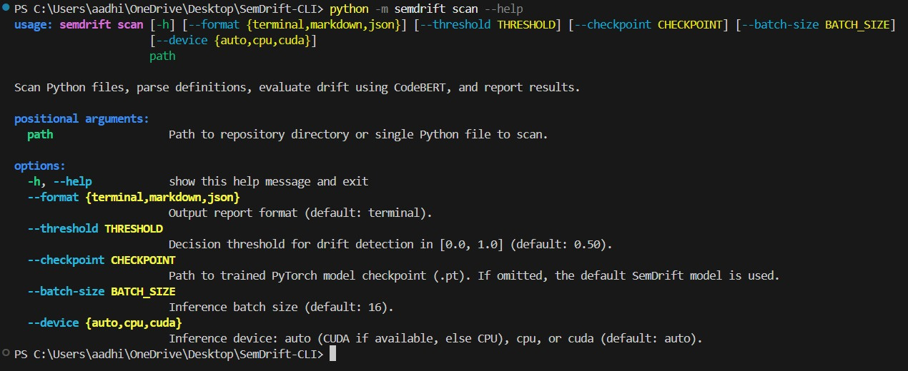
IMPLEMENTATION
03 Result
Final CLI results

Slide 12
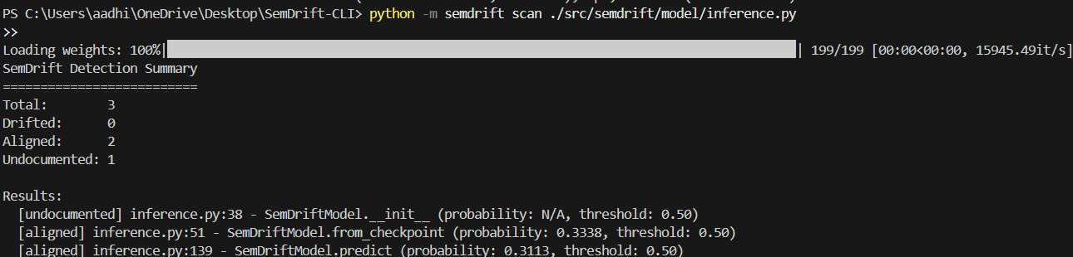
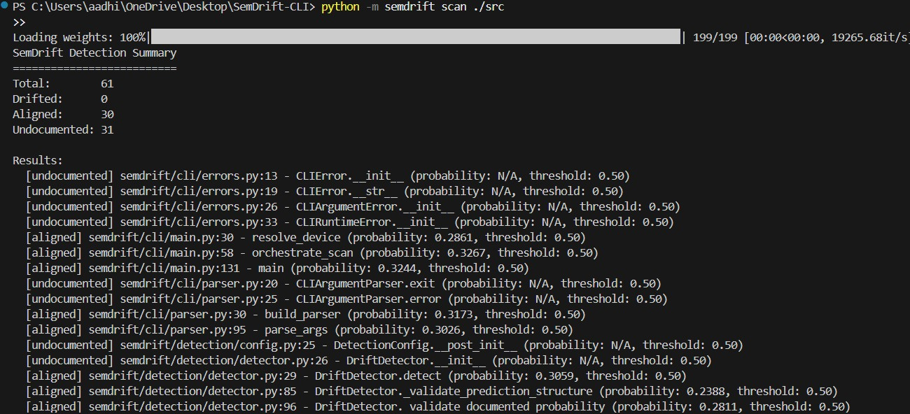
IMPLEMENTATION
03 Result
Final CLI results

Slide 13
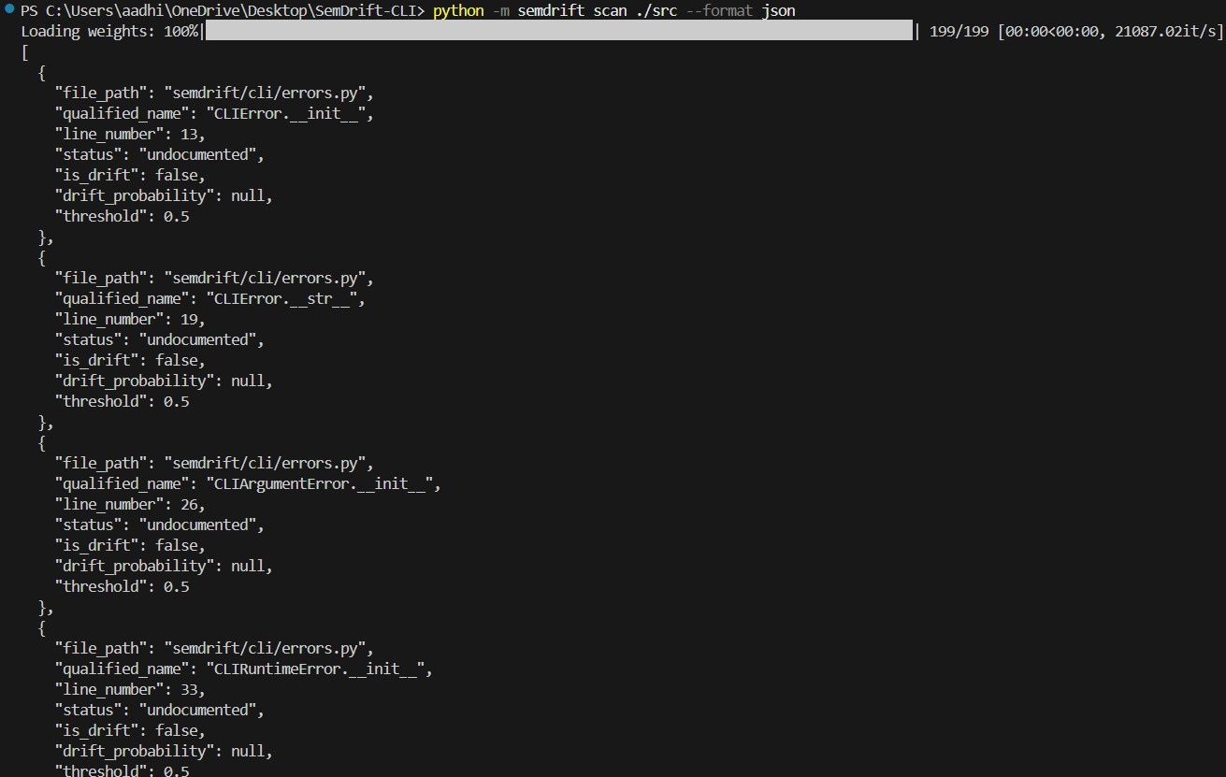
IMPLEMENTATION
03 Result
Final CLI results

Slide 14
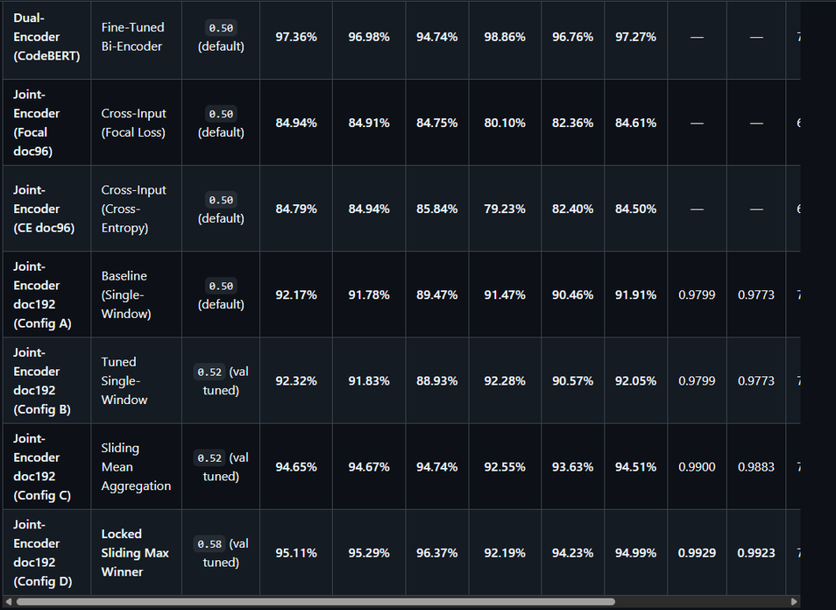
PERFORMANCE AND RESULTS
JOINT ENCODER PERFORMANCE
Accuracy: 95.11%
F1-Score: 92.7%
Balanced Accuracy: 92.08%
Sampled on total of 2000 candidates.

Slide 15

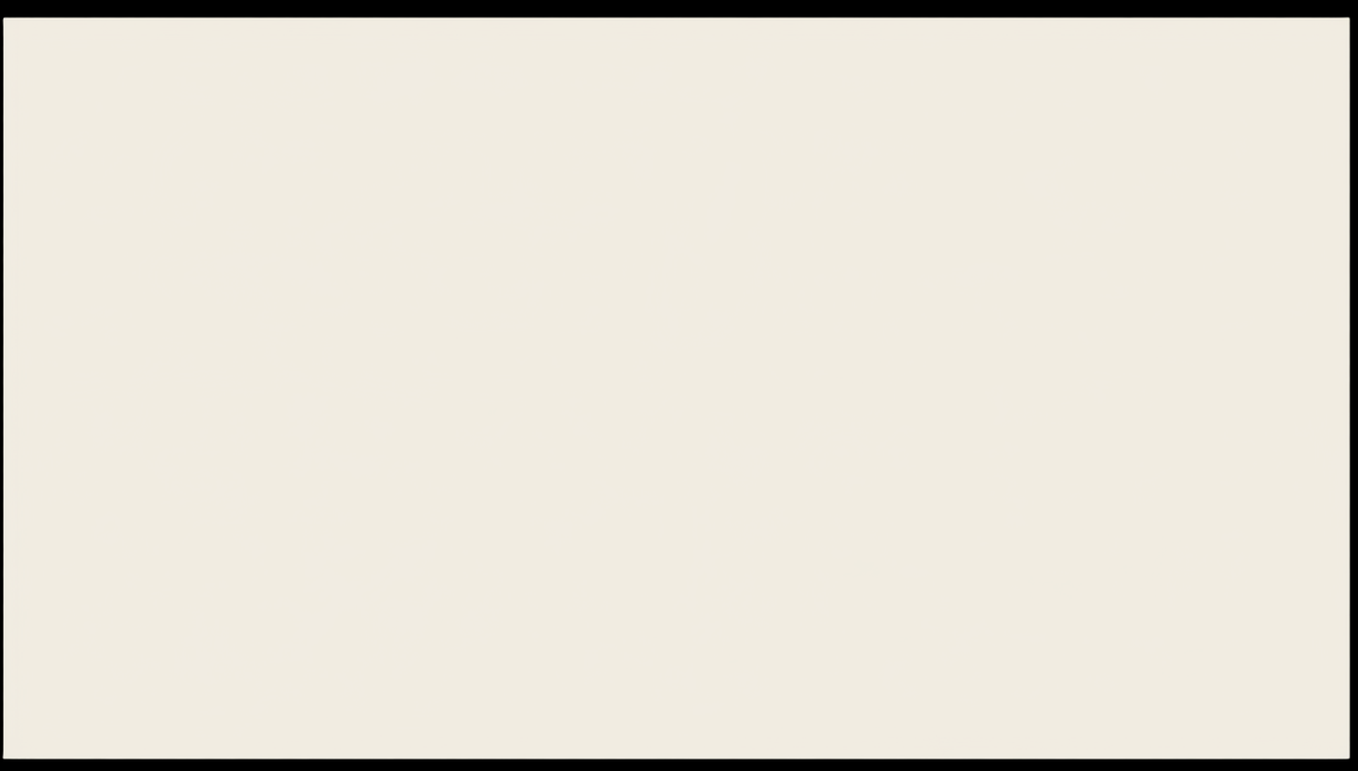


HARDWARE AND SOFTWARE REQUIREMENTS
HARDWARE
</> SOFTWARE
Language : Python 3.x
Model & Training : sentence-transformers, CODEBERT
Parsing : AST Parser (Python)
Interface : CLI — primary output
Version Control : GitHub
Development Machine : Intel i5 13 th Generation, 16GB RAM, RTX 4050.
Training Environment : RTX 4050 GPU
Storage : Local SSD

Slide 16
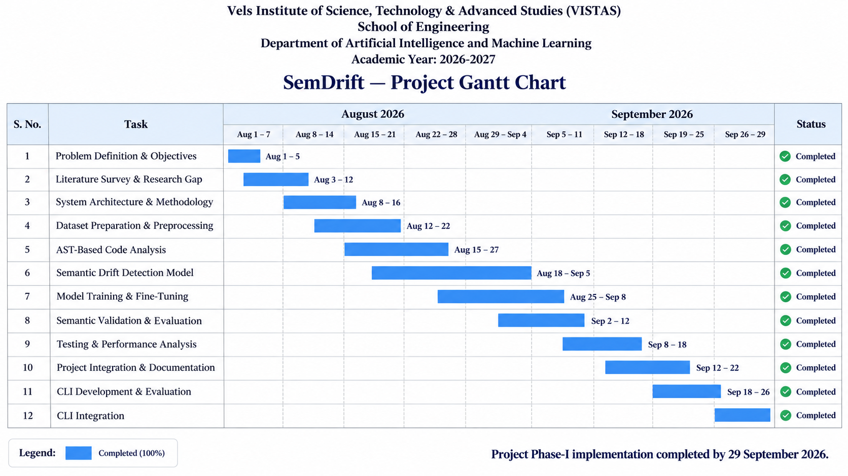

Slide 17
CHALLENGES FACED
  Real-World Drift Mining — Finding naturally occurring code–docstring inconsistencies.
  Large-Scale Data Processing — Extracting and filtering code–docstring pairs from multiple repositories.
  Temporal Analysis — Detecting meaningful changes across Git commit history.
  Model Performance Optimization – Achieving consistent performance across aligned and drifted samples required iterative model training, fine-tuning, and comparison with the baseline encoder.
  AST-Based Code Analysis – Implementing AST parsing for reliable function and docstring extraction was challenging due to variations in Python syntax, nested structures, and complex repository codebases.

Slide 18
FUTURE WORK
  Real-Drift Dataset Expansion – Mine more repositories to build a larger and more diverse real-world drift dataset.
  Universal Tree Sitter Parser – Extend SemDrift to analyze Java code and documentation in addition to Python.
  Model Enhancement – Improve encoder architecture and training strategies for better semantic drift detection.
  Practical Integration – Extend SemDrift toward automated code review and CI-based documentation consistency checking.

Slide 19
REFERENCES
Feng, Z., et al. (2020).
  CodeBERT: A Pre-Trained Model for Programming and Natural Languages.
  Findings of EMNLP 2020, pp. 1536–1547.
Kuhn, T., & Bergel, A. (2013).
  Verifiable Source Code Documentation in Controlled Natural Language.
Python Software Foundation.
  ast — Abstract Syntax Trees, Python Documentation.
  Used as the basis for AST-based source-code parsing and function extraction.
Kiecker, T., Sparka, J. A., Reuter, M., Ziegler, A., & Grunske, L. (2026).
  CASCADE: Detecting Inconsistencies between Code and Documentation with Automatic Test Generation.
Devlin, J., Chang, M.-W., Lee, K., & Toutanova, K. (2019).
  BERT: Pre-training of Deep Bidirectional Transformers for Language Understanding.
  NAACL-HLT 2019.

